Slide 1

Funding in Startups
Presented by: Archana Bharti

Slide 2
Index
Objective and Data Specifications
Methodology
Data Loading
Data Exploration
Data Cleaning/Feature Engineering
Data Visualization
Insights & Recommendations

Slide 3
Objective & Data Specification
Context:
Founding a startup with a revolutionary idea may seem very attractive, but having insights and knowledge about the condition of startups founded in the past can help in shaping future startup ideas and positioning it well in today's markets, which can ultimately lead to increasing its performance many folds, in the real world.
Objective:
1. Uncover trends and insights that guide strategic decision-making. Consider analyzing the distribution of funding across different categories, markets, and regions to identify sectors with higher investment potential.
2. Explore the correlation between a startup's founding characteristics and its funding success, examining factors such as the funding rounds, funding types, and geographical locations. Additionally, assess the impact of economic factors on funding, and propose strategies for startups to optimize their funding journeys. This project has the potential to offer valuable insights for both aspiring entrepreneurs and investors in the dynamic landscape of startup financing.
Data-set: investments_VC.csv
Tool used: Python
Libraries used:
import numpy as np
import pandas as pd
import matplotlib.pyplot as plt
import seaborn as sns
from plotly import graph_objects as go

Slide 4
Methodology (in Flow Chart format)
Start
Data Cleaning
Import required Python Libraries
Handling Missing values
Loading the given data-set
Checking data types and modifying them if needed
Data Exploration
Understanding the Variables/Features
Feature Engineering
Identifying Missing Values/ Redundant data /data inconsistency /data imbalance
Data Analysis/Data Visualization
NO
Key Findings & Insights
YES
Recommendations
End

Slide 5

Data Loading & Data Exploration

Slide 6


Data Loading & Data Exploration
Loading csv file through Pandas
Data Exploration
1. Understanding the Variables/Features
df.columns
df.info()
df.shape
df.describe()
df.head()

Slide 7
Data Exploration
2. Identifying Missing Values/ Redundant data /data inconsistency /data imbalance
Identifying duplicate rows/columns
Identifying Irrelevant columns
Identifying Missing Values
Checking the data types

Slide 8

Data Cleaning/Feature Engineering

Slide 9
Data Cleaning/Feature Engineering
Dropping rows/columns/Imputing values/Editing names/converting data types
Identifying duplicate rows/columns
Identifying Irrelevant columns
Identifying Missing Values
Checking the data types
Dropping values/rows
Dropping columns
Dropping missing values
Converting string to int
Converting float to data datatype

Slide 10

Feature Engineering
Creating new features

Slide 11

Data Visualization

Slide 12
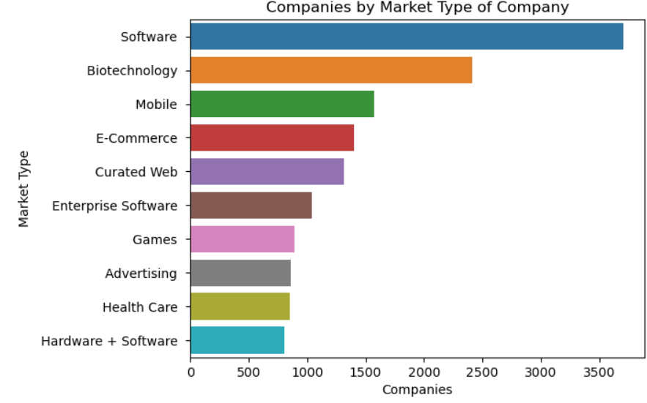
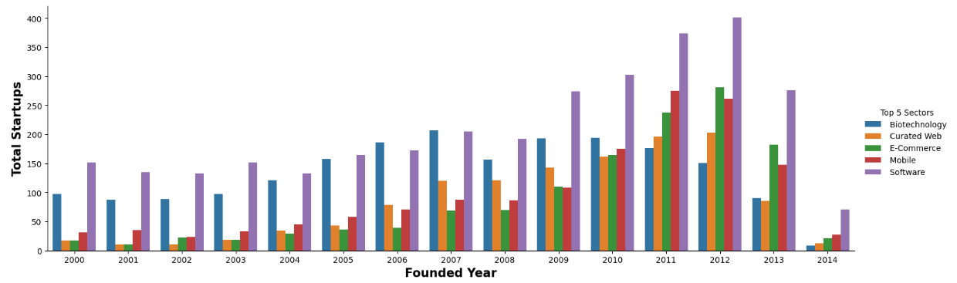
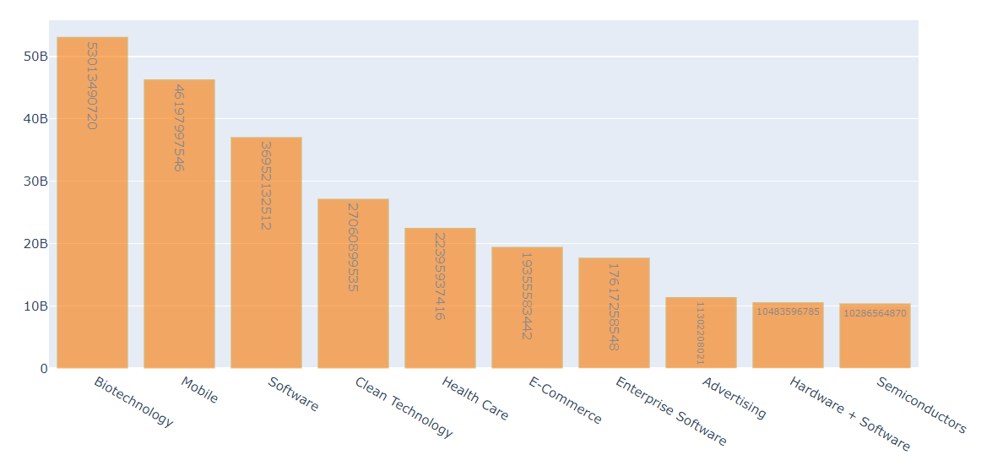
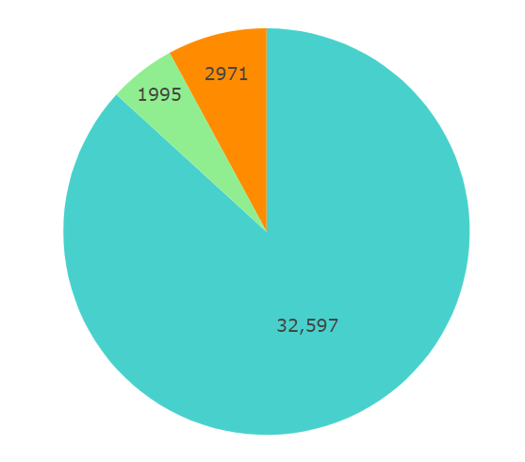

Data Visualization (1/3)
Top 10 Markets/Sectors that are Generating the Most Startups
Distribution Of Top-5 Startup Sector After Year 2020
Highest Funded Sectors
Status Of Different Startups

Slide 13
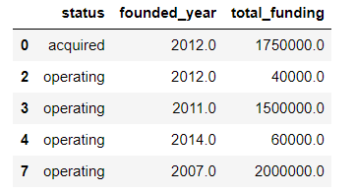
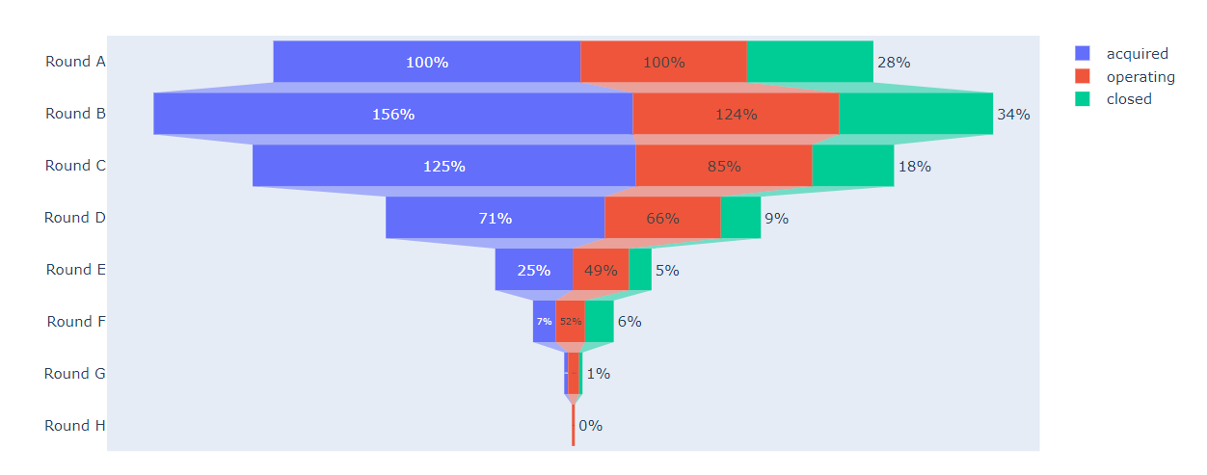
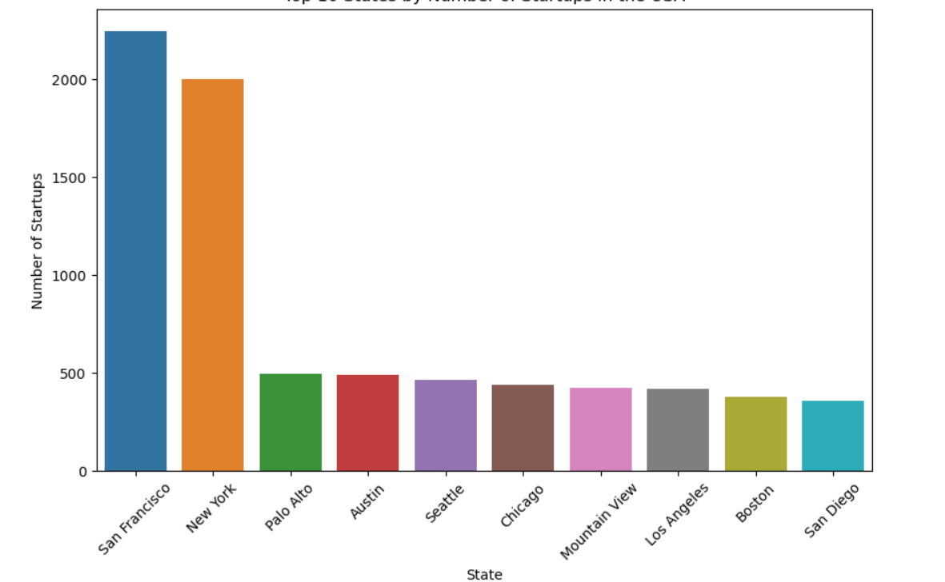
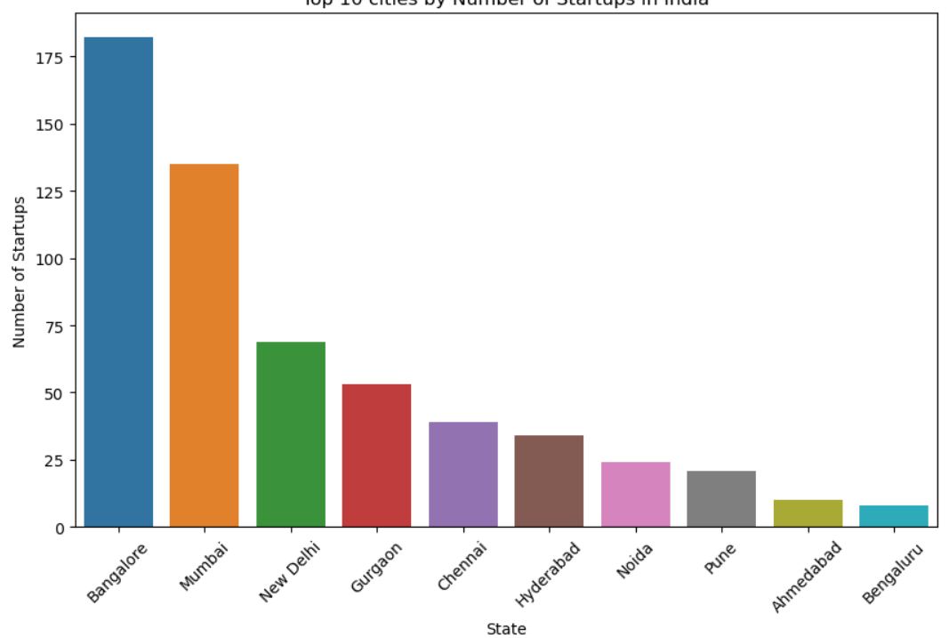
Data Visualization (2/3)
Total Fundings Considering All The Funding Types/Channels
Number Of Rounds Of Funding Each Category Received
Top 10 States by Number of Startups in the USA
Top 10 Cities By Number Of Startups In India

Slide 14
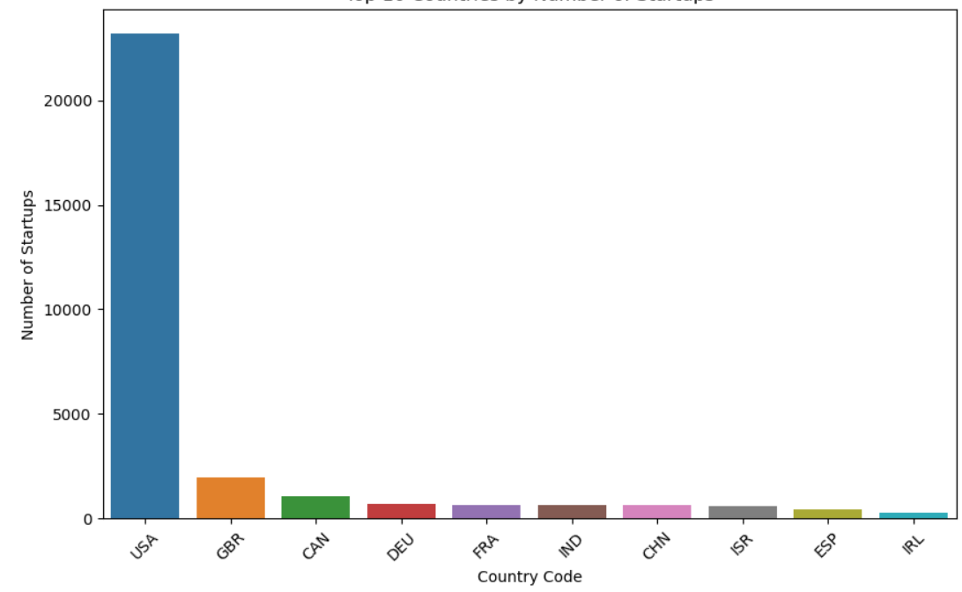
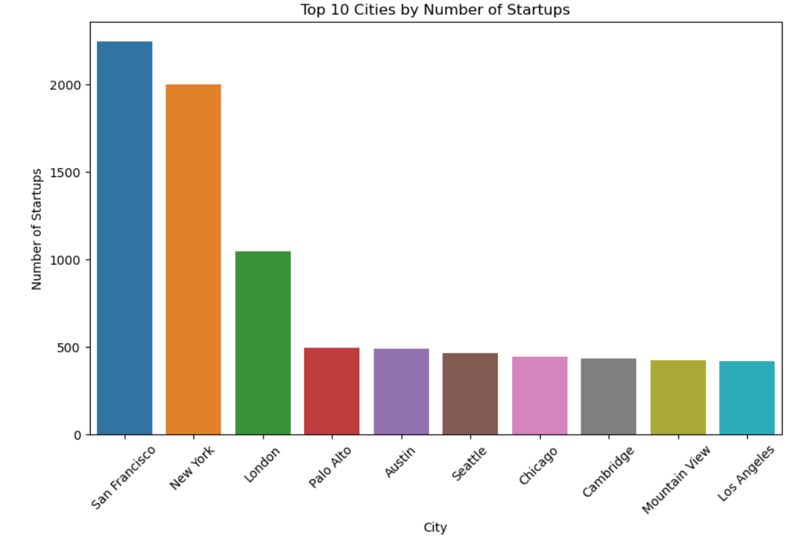
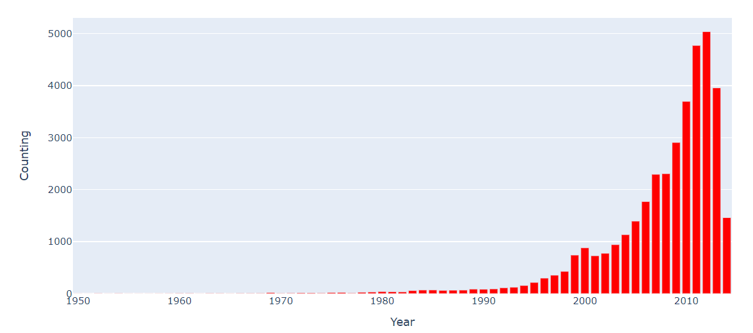
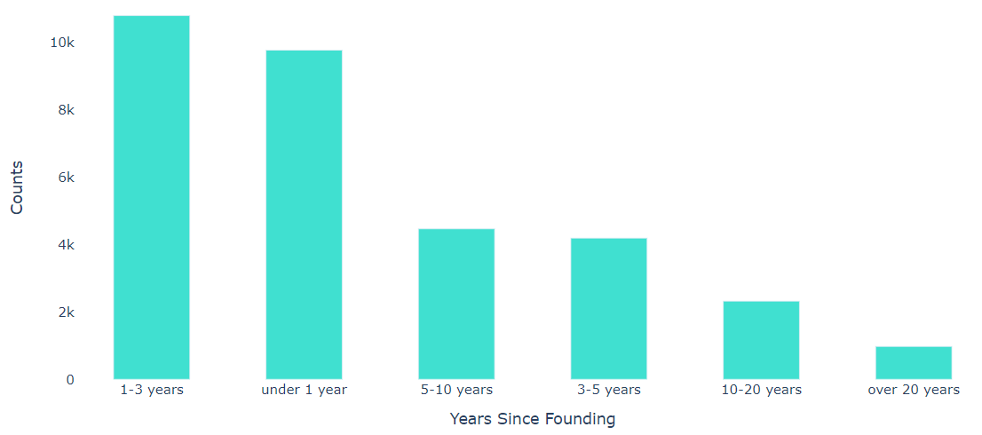
Data Visualization (3/3)
Top 10 Countries by Number of Startups
Top 10 Cities Globally by Number of Startups
Founding Years Of Startups
Number Of Startups By Years Since Founding

Slide 15

Insights & Recommendations

Slide 16
Insights (1/2)
The software sector emerges as the frontrunner in startup funding, demonstrating a strong investment trend, with biotechnology and mobile markets closely trailing behind, indicating significant investor confidence and support in these sectors.
Post-2020, the top five sectors driving funding and startup activity comprise biotechnology, curated web, e-commerce, mobile, and software, showcasing a notable shift in investment focus towards these industries.
The highest funded sectors, namely Biotechnology, Mobile, and Software, have secured substantial investment amounts, with Biotechnology leading the pack, followed closely by Mobile and Software.
The majority of startups, constituting 32,597 entities, are currently in the "operating" phase, indicating active business operations and ongoing market presence.
A significant number of startups, totaling 2,971, have transitioned to the "acquired" status, suggesting successful exits through acquisition by larger companies or investors.
Acquired startups have generally received higher funding amounts compared to operating startups.
Startups acquired in various years, such as 2012, have secured substantial funding, with funding amounts typically exceeding those received by operating startups in the same year.
Conversely, operating startups across different founding years have received comparatively lower funding amounts, indicating potential challenges in accessing significant investment capital compared to their acquired counterparts.
The disparity in funding levels between acquired and operating startups underscores the impact of acquisition events on fundraising success and highlights the importance of understanding the funding dynamics within different startup cohorts.
Acquired startups have the highest mean funding amounts across all funding rounds compared to operating and closed startups, indicating a greater level of investment and financial support in the acquisition process.
Round B appears to be the most heavily funded round for all three statuses, with acquired startups receiving the highest mean funding amount, followed by operating and closed startups.
Operating startups exhibit moderate mean funding amounts across all rounds, suggesting ongoing investment and growth opportunities despite lower funding levels compared to acquired startups.

Slide 17
Insights (2/2)
San Francisco, New York, and Palo Alto emerge as the top cities in the USA with the highest startup counts, indicating vibrant startup ecosystems and significant entrepreneurial activity in these regions.
Bangalore, Mumbai, and New Delhi stand out as the top cities in India with the highest startup counts, showcasing thriving startup ecosystems and substantial entrepreneurial presence in these metropolitan areas.
The USA dominates the startup landscape with the highest number of startups, accounting for approximately 76.75% of the total startups analyzed in the dataset, underscoring its position as a global leader in entrepreneurship and innovation.
San Francisco, New York, and London emerge as the leading cities globally, showcasing vibrant entrepreneurial ecosystems and significant innovation hubs.
The year 2012 stands out with the highest number of startups, indicating a significant influx of entrepreneurial activity during that period.
Moreover, there is a noticeable surge in the number of new startups from 2000 to 2014, reflecting a period of pronounced growth and expansion in the startup ecosystem.
A significant number of companies were able to secure funding within a relatively short period after their founding date, potentially reflecting investor confidence in their business models, products, or services. It suggests that these startups were able to attract investors quickly, which could be attributed to various factors such as innovative ideas, strong founding teams, market potential, or early traction.
A smaller proportion of startups were able to secure funding after a considerably longer period since their founding date, indicating a different investment scenario or business trajectory. Startups receiving funding after more than 20 years may represent companies that have undergone significant growth, innovation, or pivots over time, leading to renewed investor interest or strategic partnerships
A substantial number of startups received funding within their first year of founding, indicating strong early-stage investor interest
Additionally, there's a notable increase in funding recipients within the initial 3 years, indicating continued support for emerging ventures. However, there's a decline in funding recipients beyond 5 years, with a significant drop after the first decade, implying challenges in attracting investment for more mature companies. Nonetheless, a small but consistent number of startups continue to secure funding even after two decades, showcasing enduring investor confidence in select long-standing ventures.

Slide 18
Recommendations for Investors
Sector Diversification: While software, biotechnology, and mobile markets are receiving significant funding, it's essential for investors to diversify their portfolios across different sectors to mitigate risks and explore emerging opportunities in sectors like curated web, e-commerce, and health tech.
Post-2020 Investment Strategy: Investors should consider adjusting their investment strategies to align with the evolving startup landscape, focusing on sectors such as biotechnology, curated web, e-commerce, mobile, and software that have demonstrated resilience and growth potential post-2020.
Strategic Acquisitions: Companies aiming for successful exits should focus on building scalable and innovative solutions, as evidenced by the higher funding amounts received by acquired startups. Strategic partnerships and acquisitions can provide significant value to both startups and acquiring companies.
Location-Based Investments: Investors looking to capitalize on thriving startup ecosystems should prioritize investments in cities like San Francisco, New York, Palo Alto, Bangalore, Mumbai, and New Delhi, which serve as prominent hubs for entrepreneurial activity and innovation.
Early-stage Funding: Recognizing the importance of early-stage funding, investors should actively seek opportunities to support promising startups within their first year of founding, as these companies have demonstrated potential for rapid growth and scalability.
Long-term Investment Opportunities: While there's a decline in funding recipients beyond 5 years, investors should remain vigilant for long-term investment opportunities, particularly in startups with enduring value propositions, strong market traction, and innovative business models.
Support for Operating Startups: Operating startups, despite receiving comparatively lower funding amounts, represent ongoing growth opportunities. Investors should consider providing strategic support, mentorship, and funding to help these startups scale and succeed in competitive markets.

Slide 19
Recommendations for Aspiring Entrepreneurs
Sector Selection: Consider entering sectors like software, biotechnology, curated web, e-commerce, mobile, and health tech, which have demonstrated significant investor interest and funding. Conduct thorough market research to identify emerging trends and unmet needs within these sectors.
Innovation and Differentiation: Focus on developing innovative solutions and unique value propositions to stand out in competitive markets. Prioritize differentiation by offering novel products, services, or business models that address specific pain points or provide distinct advantages over existing offerings.
Strategic Partnerships: Explore opportunities for strategic partnerships and collaborations with larger companies or investors to enhance visibility, access resources, and accelerate growth. Strategic alliances can provide valuable mentorship, expertise, and funding support to fuel your startup's expansion.
Location Consideration: Evaluate startup ecosystems in cities like San Francisco, New York, Palo Alto, Bangalore, Mumbai, and New Delhi, which offer robust support networks, access to talent, and opportunities for networking and collaboration. Consider establishing your startup in locations with vibrant entrepreneurial ecosystems to leverage these benefits.
Early-stage Funding: Seek early-stage funding from angel investors, venture capitalists, or crowdfunding platforms to support product development, market validation, and initial growth. Prepare a compelling pitch deck and business plan to attract potential investors and demonstrate the viability and scalability of your startup.
Long-term Sustainability: Prioritize long-term sustainability and scalability by focusing on building a strong foundation, fostering customer relationships, and continuously iterating and improving your products or services based on feedback and market dynamics. Maintain a clear vision and adaptability to navigate challenges and seize opportunities as your startup grows.
Persistence and Resilience: Entrepreneurship can be a challenging journey with ups and downs. Cultivate persistence, resilience, and a growth mindset to overcome obstacles, learn from failures, and stay focused on your goals. Surround yourself with a supportive network of mentors, advisors, and fellow entrepreneurs to provide guidance and encouragement along the way.

Slide 20
THANK YOU
Archana Bharti

